Slide 1
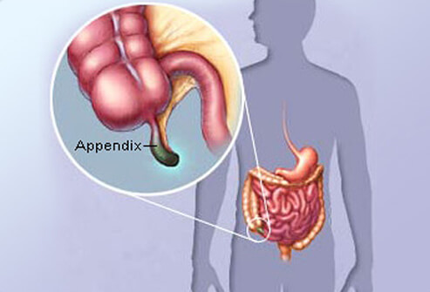

Pediatric Appendicitis Diagnosis:
Cost Effectiveness of Ultrasound vs. Cat Scan
Advanced Modeling of Public Health Interventions
Spring, 2018
Presenters:
Emily Trask-Young,MBA-MPH’18
Calvin Kong, MBA-MPH’18

Slide 2





Overview
We will cover the following topics:
Background
Diagnostics
Model
Results
Sensitivity
Research Question
Pediatric Appendicitis
Ultrasound, CAT Scan
Radiation-induced Cancer
States
Transition Probabilities
Assumptions
Cost-Effectiveness Analysis
Variables
One-way Sensitivity Analysis

Slide 3



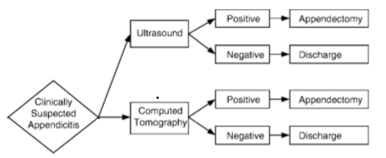


Pediatric Appendicitis Background & Diagnostics
Pediatric appendicitis is a common disease that should be treated in the most cost-effective manner as possible manner.
Pediatric Appendicitis
 | Symptoms Nausea, vomiting, pain in the lower right of abdomen Symptoms can be less “classic” in children
 | Incidence ~77,000 children get appendicitis each year 1/3 of these cases result in rupturing before they reach the operating room; more likely to rupture with delayed diagnosis
 | Diagnostics Ultrasound (US): less costly but less sensitive (0.88) Cat Scan (CT): more sensitive (0.94), but more costly and uses radiation that can cause cancer
 | Radiation Induced Cancer 20.4 cancers additional per 100,000 for men 26.1 cancers additional per 1000,000 for women
Research Question
 | Which strategy is more cost-effective in diagnosing children with appendicitis- ultrasound (US) or CAT scan (CT) when taking into account the cost of the test, complications of missed diagnosis, and radiation-induced cancer?
 | (modified from Wan et al. 2009, 380)
(modified from Wan et al. 2009, 380)

Slide 4



Cost-Effectiveness Model
In order to determine if ultrasound or CAT scans are more cost-effectiveness, we conducted a Markov simulation comparing two cohorts of 5-year-olds with symptoms of appendicitis.
Model Facts
Model
Structure
Assumptions
Beginning State: 5-year-olds with clinical symptoms of appendicitis
Cohort Size: 1000
Cohorts: UR vs. CT
Changes rate of cancer and % ruptured appendicitis cases
Delta: 1 week (1/52)
Simulation Length: 95 years
Children can have appendicitis only once, and they do so at the age of 5
Children receive no other diagnostic tests
Each person can get cancer only once
Used averages for background mortality, cancer death, cancer mortality
Included direct costs (scan costs, surgery costs, cancer costs), but not indirect costs (missed work)

Slide 5
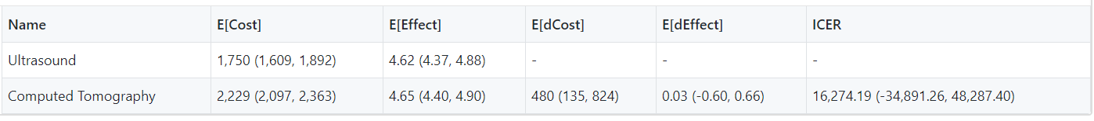
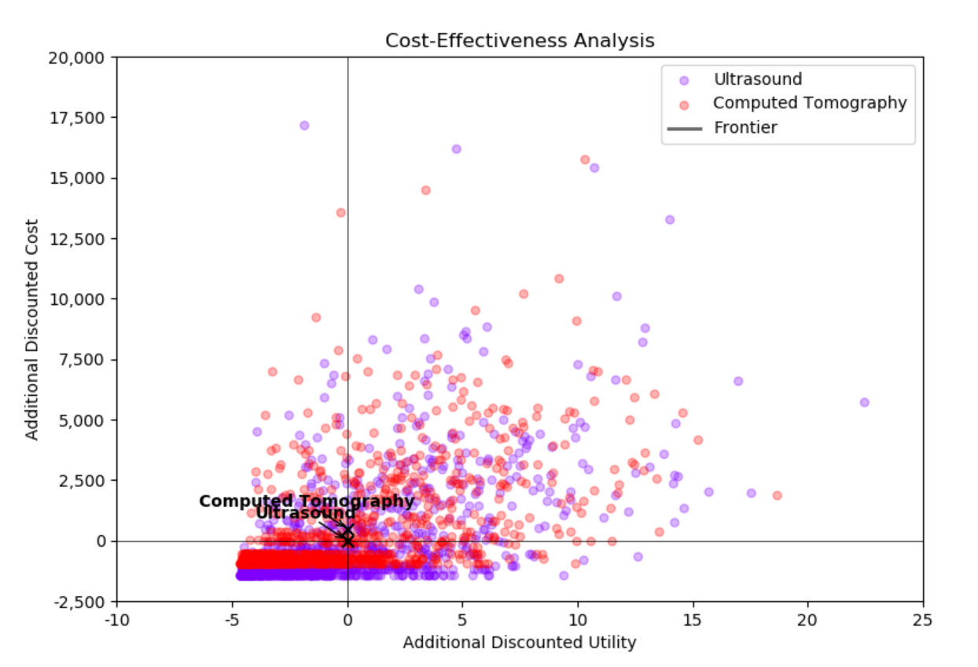
Economic Evaluation
Markov simulation results indicate that CT is a cost-effective strategy for screening pediatric appendicitis, with an ICER of $16,274.19 per QALY

Slide 6
Sensitivity Analysis
One-way deterministic sensitivity analysis suggests that the baseline evaluation results are fairly resistant to parameter uncertainty
Parameter Range (as % of Baseline)
One-way Sensitivity (Deterministic Sensitivity Analysis)
 | ICER
 | P(cancer incidence) | P(appendicitis incidence) | P(perforation after MD) | Cost of ruptured appendicitis
100% | 41989.01
50% | 39253.13
25% | 26840.80
10% | 20540.62
Baseline | 16274.19 | 16274.19 | 16274.19 | 16274.19
-10% |  | 28975.31 | 16280.52 | 16258.48
-25% |  | 28906.63 | 16280.52 | 16234.92
-50% |  | 28813.82 | 16293.19 | 16195.65
 | Cancer incidence | Appendicitis incidence | Perforation incidence after MD | Cost of ruptured appendicitis
100% | 0.004804894
50% | 0.003603671
25% | 0.003003059
10% | 0.002642692
Baseline | 0.002402447 | 0.5720 | 0.7740 | 20072.00
-10% |  | 0.5148 | 0.6966 | 18064.80
-25% |  | 0.4290 | 0.5805 | 15054.00
-50% |  | 0.2860 | 0.3870 | 10036.00

Slide 7
Questions?

Slide 8
Appendix:

Slide 9
References:
American Cancer Society Medical and Editorial Content Team. 2018. “Lifetime Risk of Developing or Dying From Cancer.” American Cancer Society. https://www.cancer.org/cancer/cancer-basics/lifetime-probability-of-developing-or-dying-from-cancer.html
“Appendicitis” 2018. Mayo Clinic. https://www.mayoclinic.org/diseases-conditions/appendicitis/symptoms-causes/syc-20369543
CDC. 2018. “National Vital Statistics Program: Mortality Data.” Centers for Disease Control. https://www.cdc.gov/nchs/nvss/deaths.htm
Johns Hopkins Medicine. 2007. “Does This Child Have Appendicitis? Watch Out for Key Signs.” https://www.hopkinsmedicine.org/news/media/releases/does_this_child_have_appendicitis_watch_out_for_key_signs
Newman K, Ponsky T, Kittle K, et.al. 2003. “Appendicitis 2000: variability in practice, outcomes, and resource utilization at thirty pediatric hospitals.” J Pediatr Surg 38(3): 372–379.
Pena BM, Taylor GA, Fishman SJ, Mandl KD. 2002. “Effect of an imaging protocol on clinical outcomes among pediatric patients with appendicitis.” Pediatrics 110(6):1088– 1093.
Wan, Michael, Murray Krahn, Wendy Ungar, Edona Caku, Lillian Sung, L. Santiago Medina, and Andrea Doria. 2009. “Evidence Based Practice: Acute Appendicitis in Young Children: US versus CT.” Radiology 250(2): 378-386.

